Slide 1
INDIVIDUAL PROJECT BY
UDOH CHIDERA JENNIFER
DATA ANALYST

Slide 2
OVERVIEW
This project is about getting insights on a 2018 fast food habit questionnaire from kaggle.com.
The target audience were Nigerians living in Island, Lagos
The questionnaire gathered answers on the following from the audience
Age
Gender
How often do you eat from fast foods each month?
What does your purchase mostly consist of?
What do you look for when choosing a fast food restaurant?
When it comes to ordering, which do you prefer the most?
What about a fast food restaurant endears you to them?
Most visited fast food

Slide 3
RATIONALE FOR STUDY
As a Registered Dietitian, my interest has been on understanding why the increased consumption of processed meals, analyzing this data set will be able to enlighten me on the characteristics of fast foods, what some Nigerians consider as fast foods and why they will patronize restaurants.

Slide 4
Tools used for Data Analysis
SQL
Microsoft Excel

Slide 5
AGE

Slide 6
GENDER

Slide 7
LOCATION
The study covered these few locations in Lagos
Magodo
Victoria Island
Lekki Phase
Gbagada
Ikoyi

Slide 8
WHAT PURCHASE MOSTLY CONSIST OF

Slide 13
Most preferred method of ordering meals
Order in a physical store and takeaway | 136
Order in a physical store and dine in | 89
Order online and get delivered | 75
Order in a physical store and dine in;Order in a physical store and takeaway | 49
Order online and get delivered;Order in a physical store and takeaway | 37
Order online and get delivered;Order in a physical store and dine in | 13
Order online and get delivered;Order in a physical store and dine in;Order in a physical store and takeaway | 12
Order online and pick up | 8
Order online and get delivered;Order in a physical store and dine in;Order online and pick up;Order in a physical store and takeaway | 7
Order in a physical store and dine in;Order online and pick up;Order in a physical store and takeaway | 5
Order online and get delivered;Order online and pick up | 4
Order online and pick up;Order in a physical store and takeaway | 3
Order in a physical store and dine in;Order online and pick up | 2
When it comes to ordering, which do you prefer the most? | 1
Order online and get delivered;Order online and pick up;Order in a physical store and takeaway | 1

Slide 14
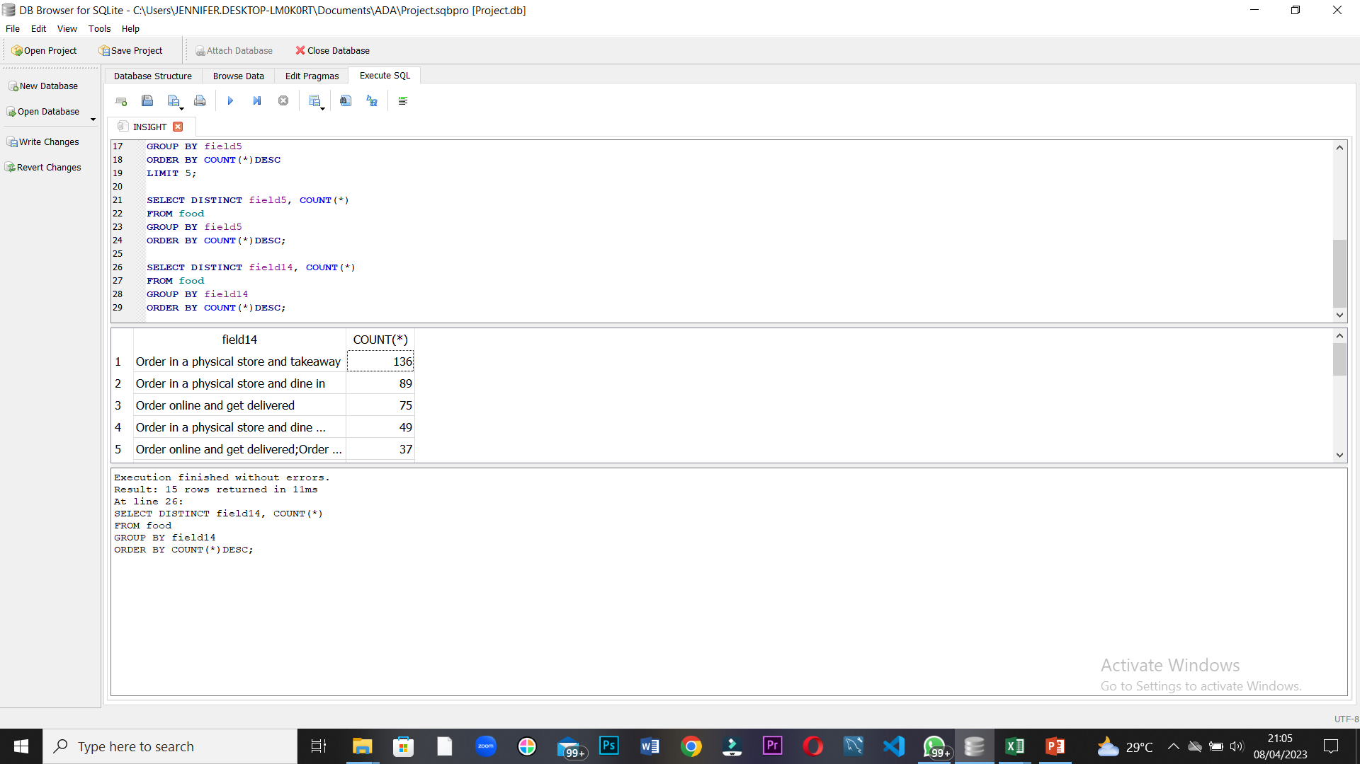

Slide 15
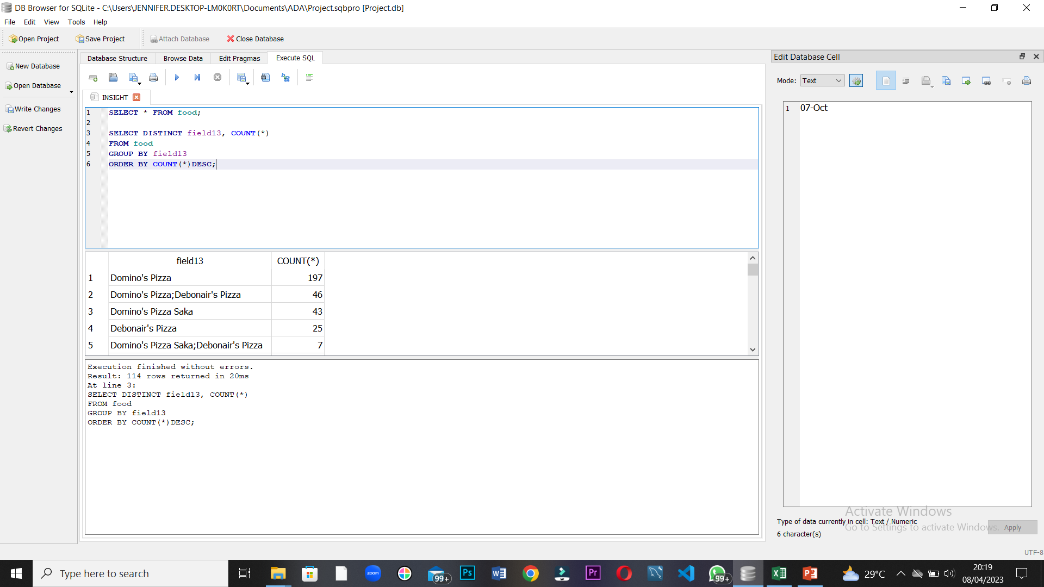
Top 5 most visited place in the last 2 months by participants

Slide 16
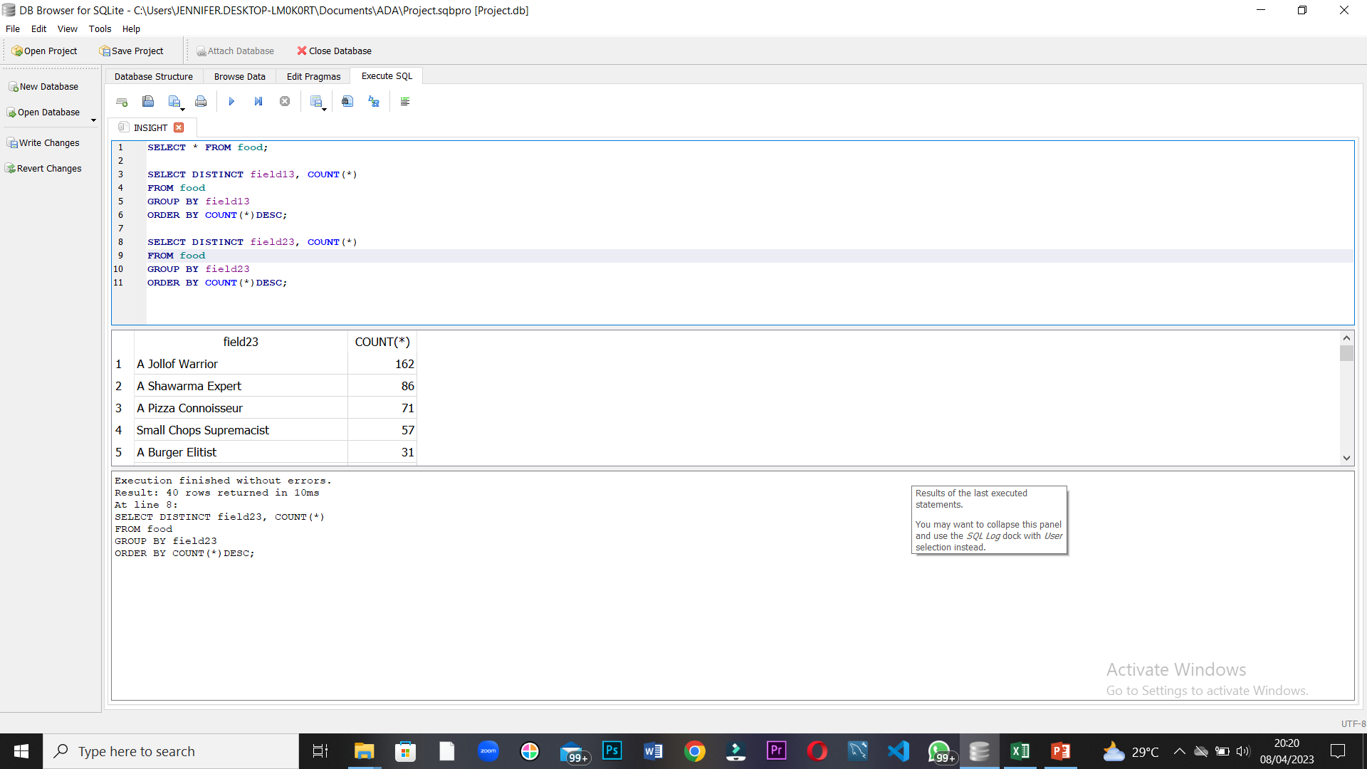
TOP 5 FAST FOODS

Slide 17
What about a fast food restaurant endears you to them?

Slide 18
SPECIAL OFFERS

Slide 19
QUALITY

Slide 20
VALUE FOR YOUR MONEY

Slide 21
CONVENIENCE

Slide 22
EXCELLENT SERVICE

Slide 23
PRICE

Slide 24
SOCIAL MEDIA SAVVINESS

Slide 25
SUMMARY ON THE INSIGHTS FROM THE SURVEY
440 participants were surveyed on their fast food habits, out of which 273 were females and 167 males.
The survey shows that although more than 50% of the target population are willing to eat Nigerian dishes as fast food, their emphasis was on Jollof rice only.
The top 5 fast foods consumed were Jollof rice, small chops, sharwama, pizza and burger.
The target population were more likely to consume Nigerian Jollof and pizza than Burger.

Slide 26
Up to 50% of the target population agreed that these are the reasons that affects their choice of restaurants
Convenience
Quality
Excellence
Special offers
Value for money
Price
They were indifferent about social media savviness being a reason they will patronize a restaurant.

Slide 27
CONCLUSION
Fast food are called fast for a reason, because they are very convenient for the consumer.
However, Nigerians need to be educated on the right way to consume these meals to avoid depending solely on processed foods instead of whole meals.
Food professionals and food organizations should work on making our healthy whole local meals possess these characteristics Nigerians desire in their meals.
This way healthier eating habit can be incorporated into fast food habits and modify what people now accept as convenience meals.

